Slide 1


<Lecture Name=” White hats ”
Lecturer =”Toktam Ramezanifarkhani”
Affiliation =”University of Oslo”
Email =”toktamr@ifi.uio.no”
/>
DevSecOps - Background, Status and Future Challenges

Slide 2
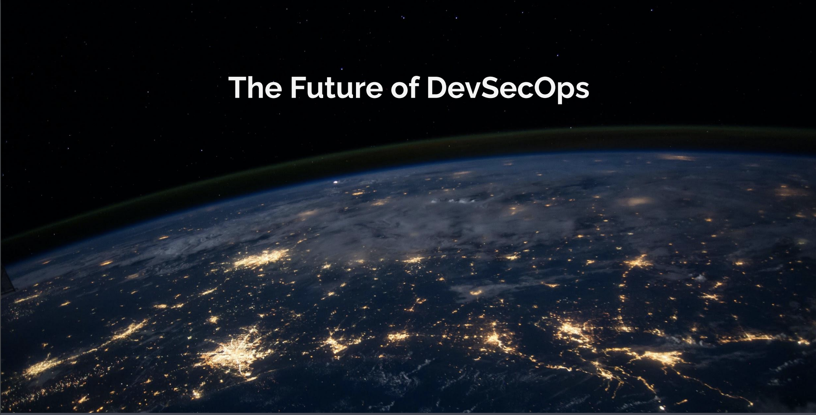
DevSecOps - background, status and future challenges​
<Lecture Name=” White hats ”
Members=”Toktam Ramezanifarkhani”
Affiliation=”University of Oslo”
Email=”toktamr@ifi.uio.no”
/>
DevSecOps - background, status and future challenges
Notes:
The transition from traditional software engineering method
ologies
(e.g., waterfall model) to DevSecOps is widely re
ported
to be a challenging task

Slide 3
Overview
The past
The present
The future
Where things are at today
Take a look into the crystal ball
Ride down memory lane
10/1/20

Slide 4


Slide 5
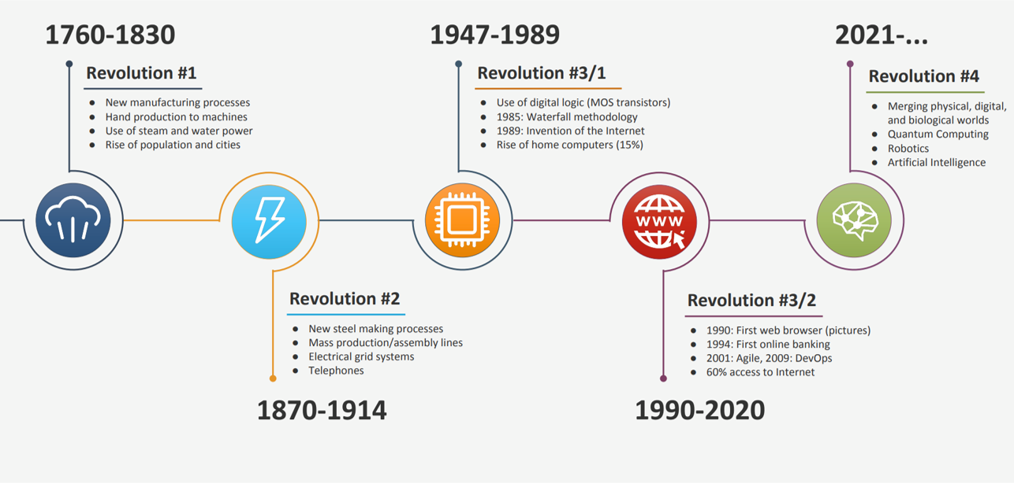
The industrial revolutions

Slide 6
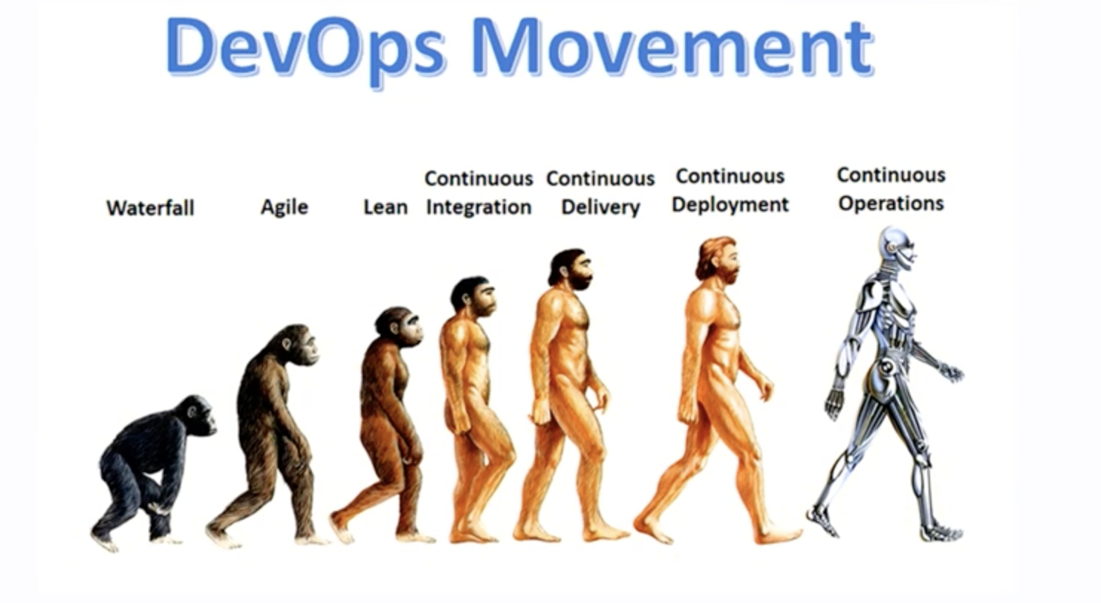
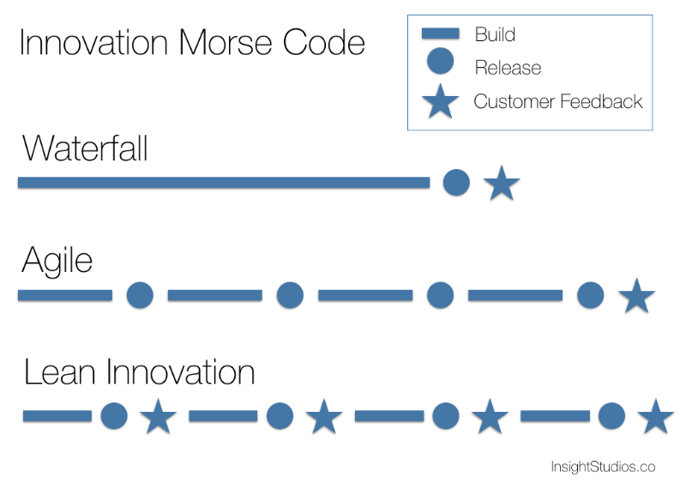
DevOps Movement

Slide 7
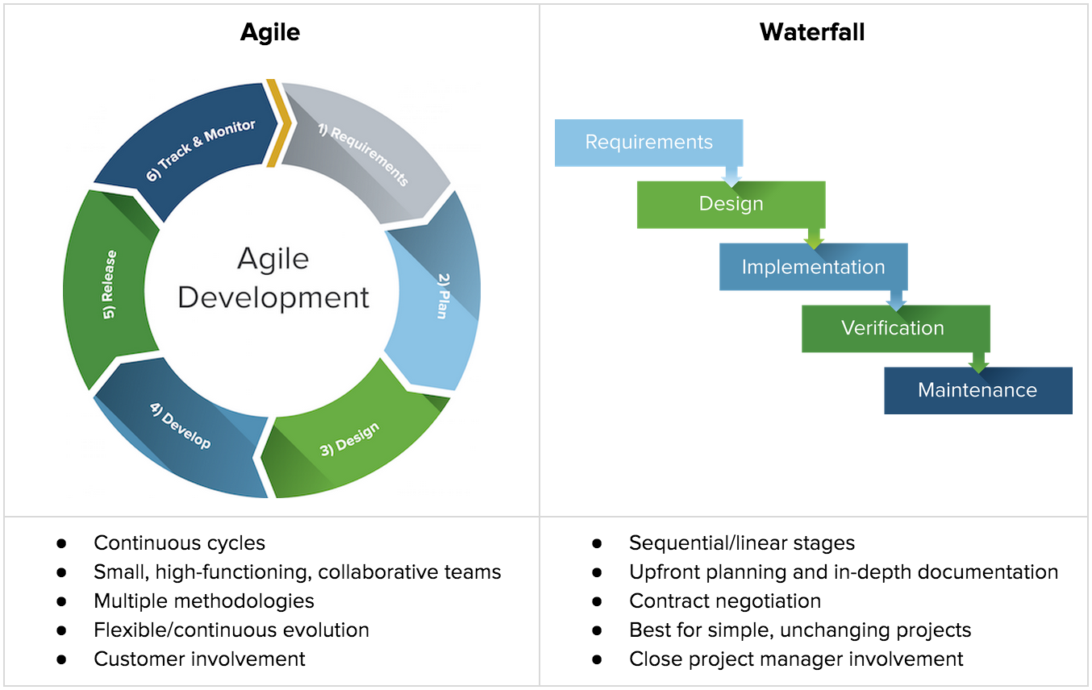

The industrial revolutions

Slide 8
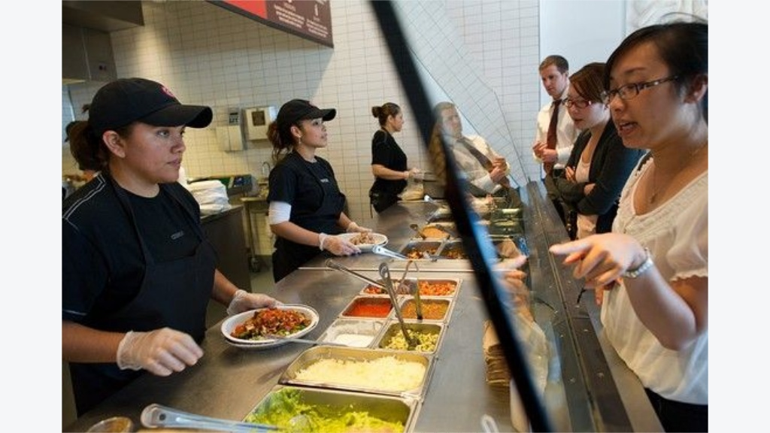
Pipeline

Slide 9
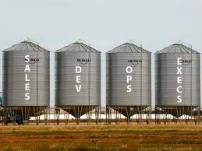
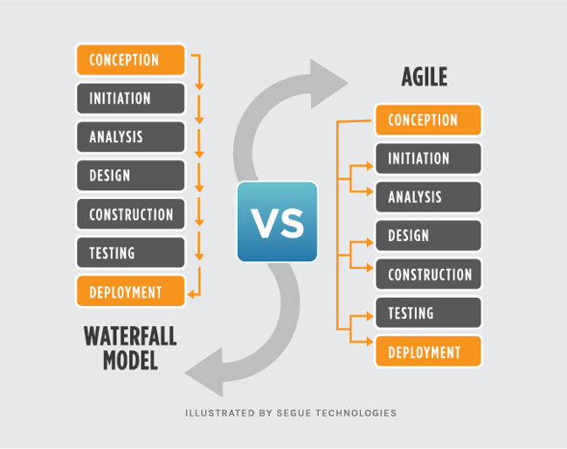
SILO MADNESS: HOW TO PUT AN END TO SILOS

Slide 10
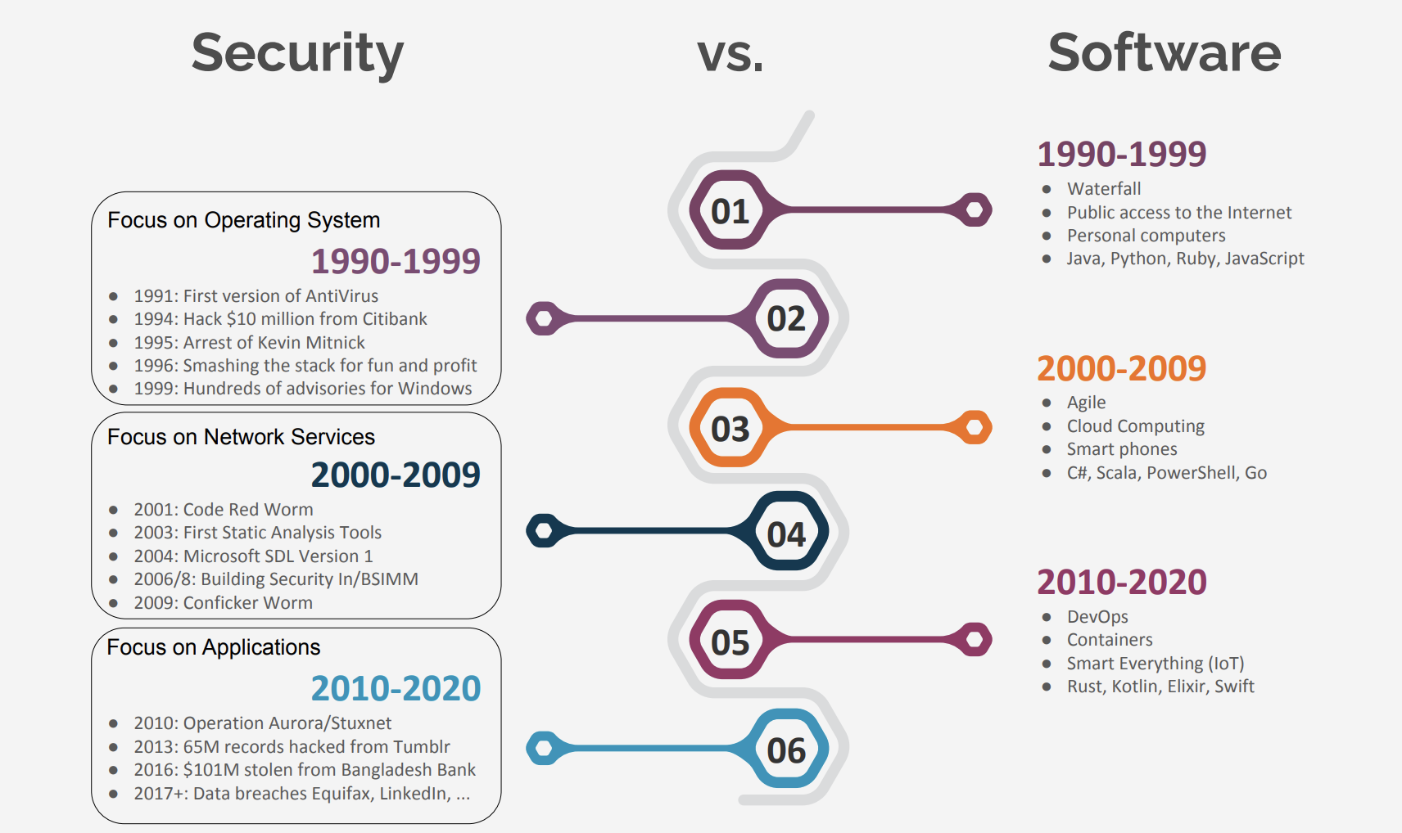
The industrial revolutions

Slide 11
DevOps (Development and Operations)
maintaining the agility
deploy releases faster
more frequently
ensuring the security of the software
A paradigm aimed at removing the traditional “silos”
One of the most widely adopted paradigms in the industry

Slide 12

Challenges
Solutions

Slide 13
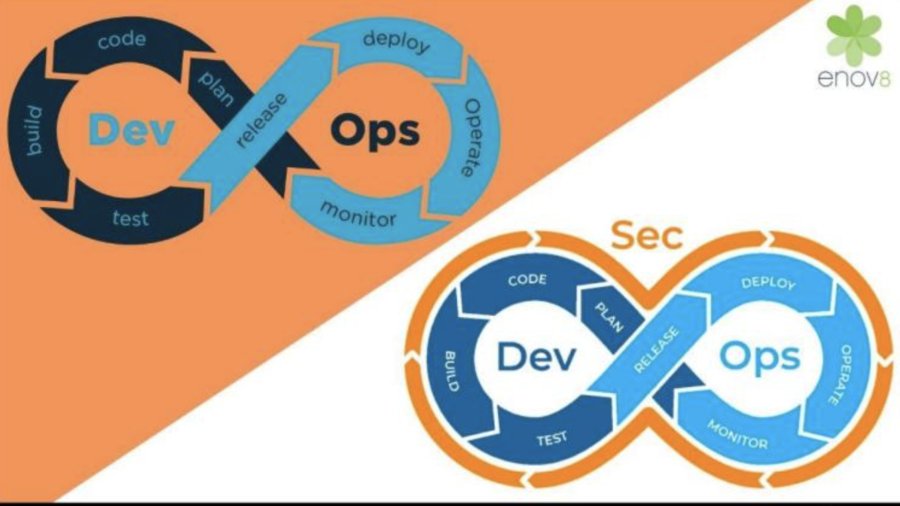
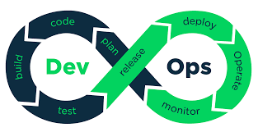
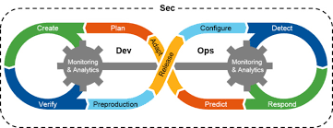
DevOps vs DevSecOps
Shift left the starting point of security
Notes:
the security of
software is critical in today’s context, particularly in a cloud
environment. There are many examples of how software security
vulnerabilities have been exploited to cause substantial
damages to organizations
At the core of DevSecOps is
the principle of keeping security as a priority and adding secu
rity
controls and practices into the DevOps cycle [6].
Development, Security and Operations (DevSecOps)
The paradigm of DevSecOps refers to the integration of security
principles and practices in DevOps through increased communication,
collaboration and integration between the development
and operations teams with the security team [
practices include
continuous activities such as CI, CD, and CDE.

Slide 14
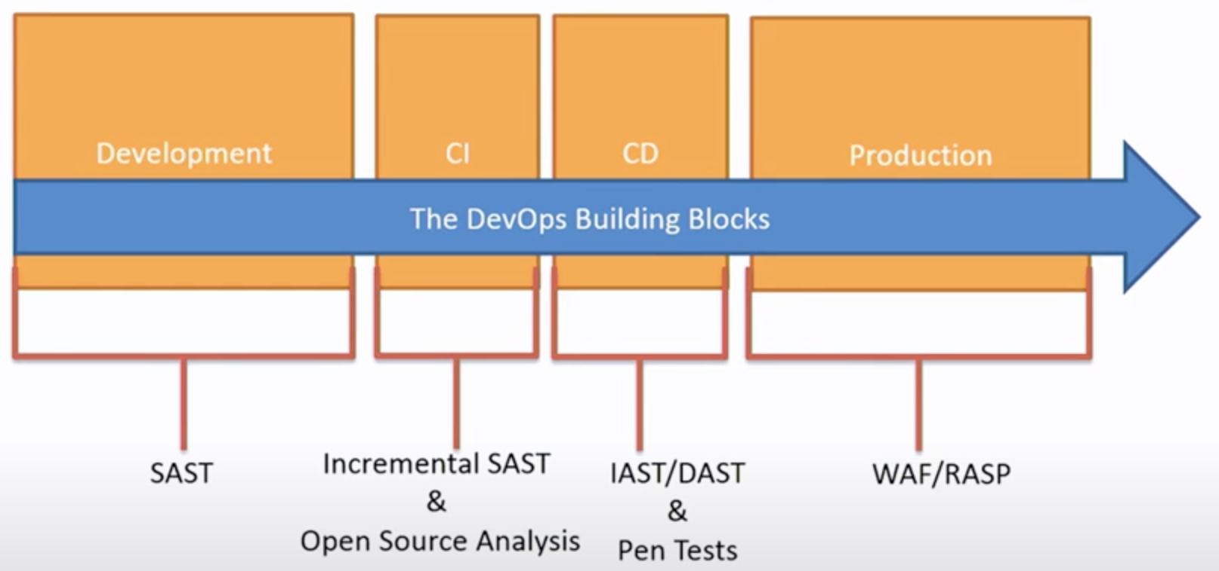
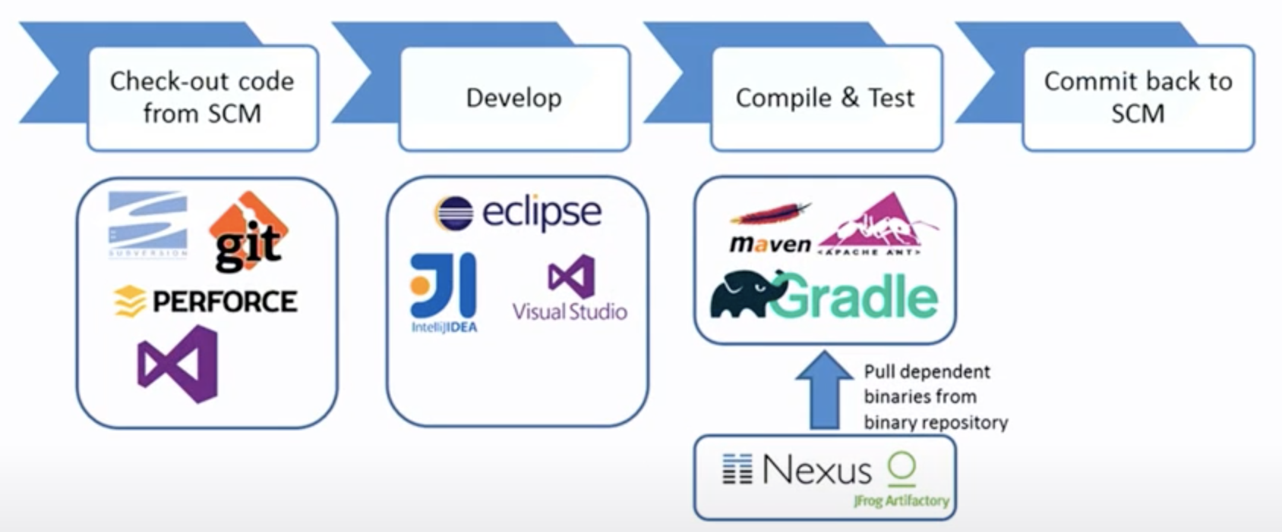
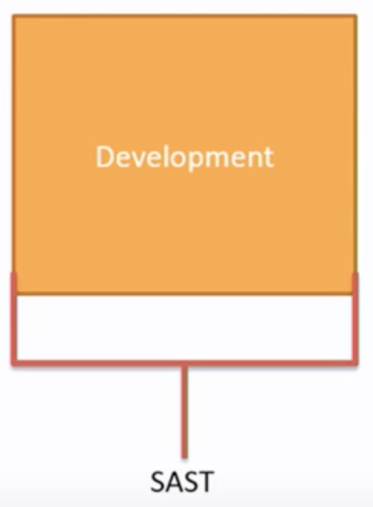
DevOps building blocks
Development
CI
CD
Production
Development

Slide 15
DevOps building blocks (2)
Continuous Software Engineering (CSE)
continuous software engineering activities, rather than a set of discrete activities performed by different teams or departments
Continuous Integration (CI)
developers frequently integrate their work (e.g., code changes) to the main branch (daily)
changes are validated by automated builds, and tests
developers can detect and address integration failures early and as quickly as possible
Continuous Delivery (CDE)
keep the software at production-ready state at any time
software relevant tests and quality checks in a staging environment acceptance tests
Development
CI
CD
Production
Continuous Deployment (CD)!
Notes:
Continuous Delivery (CDE)
keep the software at production-ready state at any time
software needs to pass the relevant tests and quality
checks in a staging environment (e.g., acceptance tests).
Continuous Deployment (CD)
operation

Slide 16
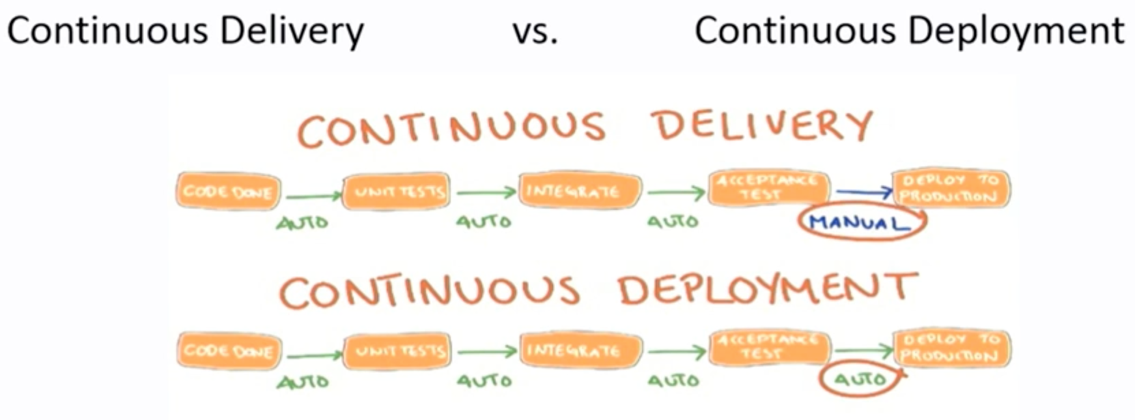
Conflicts of definitions
Huge difference in security
You have no chance to stop the automation
Manually you can! however, you don’t know what to do and how!
Notes:
https://www.youtube.com/watch?v=Qa_Fq7wWRdA&t=251s
7:44

Slide 17
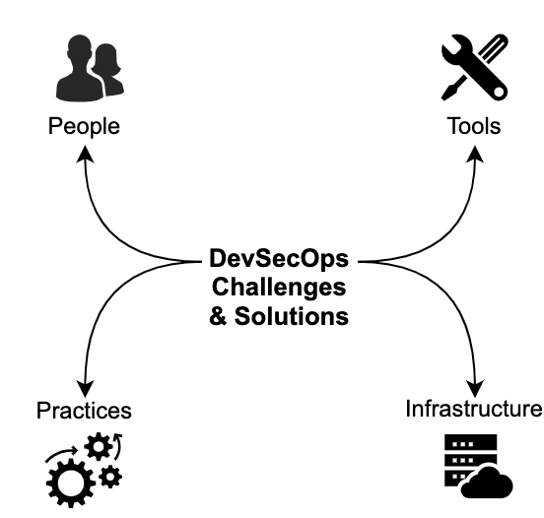


DevOps and DevSecOps Concepts
Processes: Automated deployment pipeline
Culture: Set of principles and practices for efficient communication and collaboration
People: knowledge and skills, multidisciplinary team work
Practice and infrastructure, difficulties in integrating manual security practices
technologies: supporting tool chain
tool, vulnerabilities
Notes:
People
This theme covers issues related to knowledge and skills¨ the
collaboration of the multidisciplinary team members of DevSecOps¨ and
the organizational culture ®eÆgÆ inter≠team collaboration issues leading to
DevSecOps adoption challenges©Æ
Practices∫ This theme covers issues related to DevOps or continuous
practices ®eÆgÆ CIØCD© and integrating security practices ®eÆgÆ difficulties in
integrating manual security practices into DevSecOps©
Tools∫ This theme covers issues related to tools used in DevSecOps¨
their usage scenarios¨ and the pipeline ®eÆgÆ Vulnerabilities in containers©Æ
Infrastructure∫ This theme covers issues related to adopting DevSecOps
in various types of infrastructures ®iÆeÆ complex cloud environments©
Shift left the starting point of security

Slide 18

DevSecOps Demo - Example
https://www.youtube.com/watch?v=ijGt0IavTVQ

Slide 19
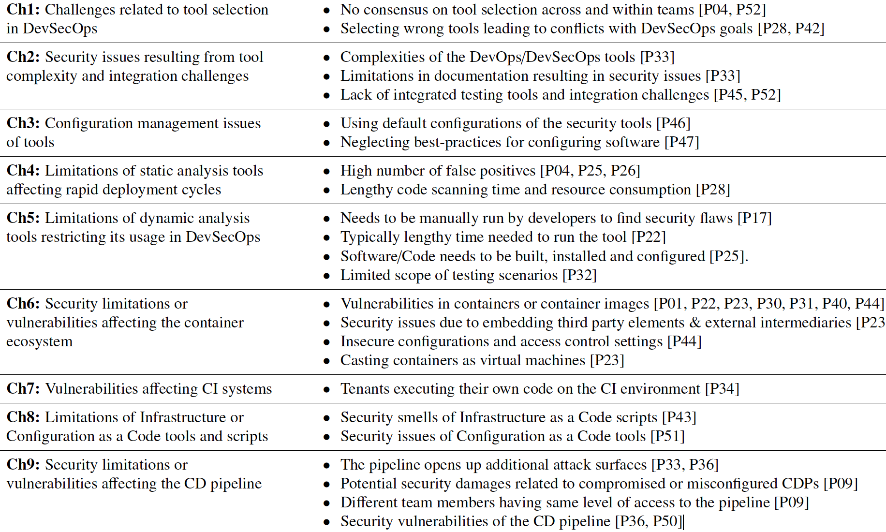
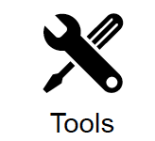

Slide 20
Ch1: challenges related to tool selection
highly encouraged tools - heavily rely on tools
Variety of tool-sets between security and other teams
Adverse
effects or conflicts by
changing security tools
Security
tools exponentially increased the duration
unsuitable tools have negative effect on the security
the lack of standards for tool selection is a security automation challenge
rapidly deploying insecure software
Notes:
Axe tool ha ro biar
The usage of tools is highly encouraged in the DevSecOps
the DevOps related practices heavily rely on tools
the differences in tool-sets between security and other teams
choosing various tool-sets even the same team
changing security tools during the project has adverse effects or conflicts
scanning tool exponentially increased the duration of the integration cycle
the usage of unsuitable deployment tools could have a negative effect on the security of software
This could lead to rapidly deploying insecure software
the lack of standards for tool selection is a challenge related to the security automation goal of this domain.

Slide 21
Ch2, 3: tool complexity, integration & configuration
DevOps and security tools suffer from complexity
developers lack of security training or skills
The lack of clear documentation e.g. the least privilege security settings
Ch4: Limitations of static and dynamic analysis tools
manual and time-consuming setting
Assessment of false alarms
Ch6: vulnerabilities of the container ecosystem
a large range of reusable artifacts e.g. container images
limiting the reuse of existing components (e.g., libraries or virtual machines), despite the fast deployments
Ch7,9: CI and CD pipeline tools are more vulnerable
Different team members (Dev/Sec/Ops) having the same level of access
Ch8: Configuration as a Code (CaC) tools and scripts and Infrastructure as Code (IaC)
these tools act as configuration agents of infrastructure, networks, and other computing resources used in CD or DevOps
Notes:
Static analysis or Static Application Security Testing (SAST)
Dynamic analysis or DAST

Slide 22
Tools related solutions
tools supporting the DevSecOps paradigm (e.g., continuous vulnerability assessment tools)
Hybrid tools such as IAST
moving to cloud solutions for security testing, when it reduces the drawbacks of existing tools (e.g., SAST)
A range of methods, guidelines, and tools
addressing the vulnerabilities and security limitations of tools
Notes:
tools supporting the DevSecOps paradigm (e.g., continuous vulnerability assessment tools)
Hybrid tools such as IAST
moving to cloud solutions for security testing, when it reduces the drawbacks of existing tools (e.g., SAST)
A range of methods, guidelines, and tools
addressing the vulnerabilities and security limitations of tools

Slide 23
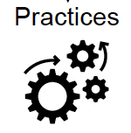
Challenges related to Practices
Inability to automate traditionally manual security
DevOps practices focus on speed and agility than security
Security assurance through comprehensive testing is time-consuming
Developers face trade-offs between speed and security
Incompatibility between security and DevOps
Shifting left security
Continuous security
Automation of certain practices
Security metrics

Slide 24
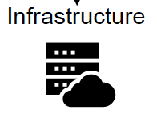
Infrastructure challenges
Nature of certain challenging infrastructures
Distributed environments
Heterogeneous environments
Segregated environments
Policies (e.g., access control) conflicting with DevSecOps principles or practices
The frameworks provide holistic solutions targeting DevSecOps

Slide 25

People related challenges
The inability of team members or the management to engage in the required culture change in DevSecOps
Developers lacking security skills is a critical issue

Slide 26
Solutions to people-centric challenges
Security champions for DevSecOps is a key recommendation
Continuous and frequent inter team collaboration
Highlight the need for controlled and standardized communication strategies
Security knowledge sharing and training activities to carry out security tasks

Slide 27
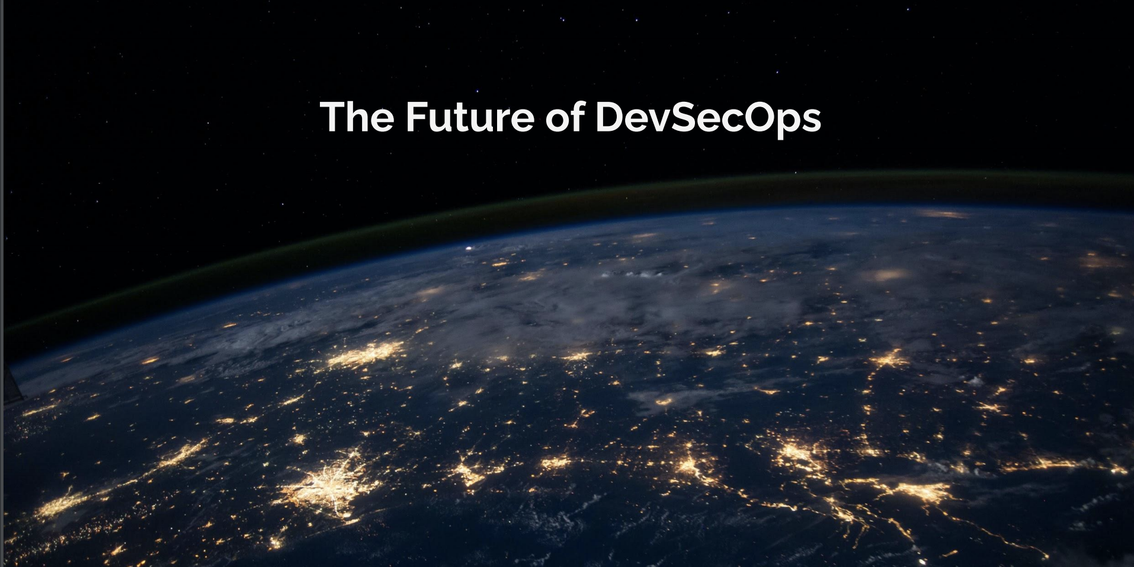
The opportunities for future research
Gap areas for technological development

Slide 28
Gap areas
The need for application security testing tools and methods(e.g., rapid CI/CD cycles) as a service
Evaluated tools considering development workflow (i.e. developer-centered security solutions).
Developers guidance on how the trade-off between release speeds and security
Automation of security practices
Security metrics introducing and validation
Security roles of the team members in DevSecOps.
Socio-technical studies focusing on the people-centric challenges and their effects (e.g., tool usage).
Notes:
the need for application security testing tools and methods(e.g., rapid CI/CD cycles).
application security testing methods (e.g., DAST) as a service
Gap area: We advocate for empirically evaluated tools
which target developers in their development workflow (i.e.
developer-centered security solutions).
Gap area: Developers need to be presented with specific
guidance on how the trade-o between DevOps release
speeds and security of the software can be eectively balanced
in a practical setting.
Gap area: More work is needed to establish consensus on
proposals such as shift left security and how traditionally
manual security practices can be automated to suit the DevSecOps
paradigm.
Gap area: While researchers have stated the importance
of introducing security metrics into DevSecOps practices, a
very limited number of studies have established such metrics
by empirically validating them.
Gap area: More eort needs to be directed at clearly defining
the security roles of the team members in DevSecOps.

Slide 29
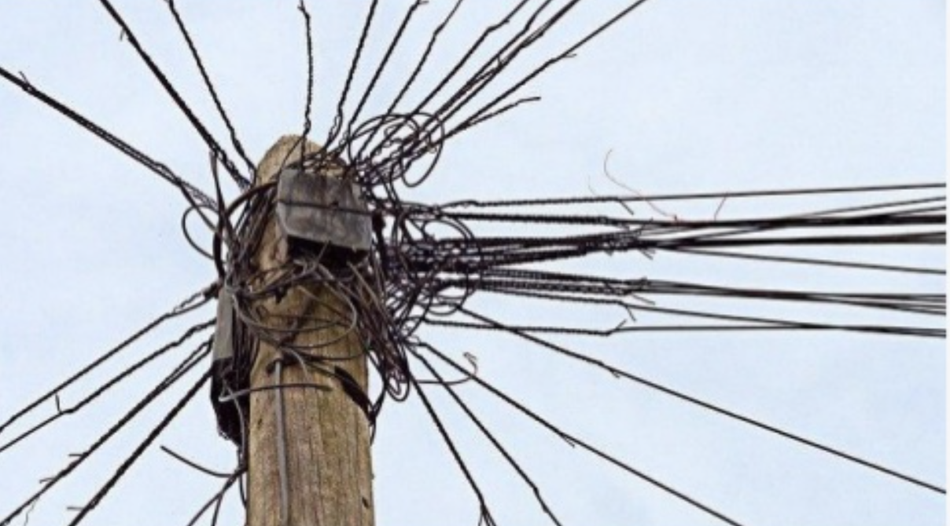
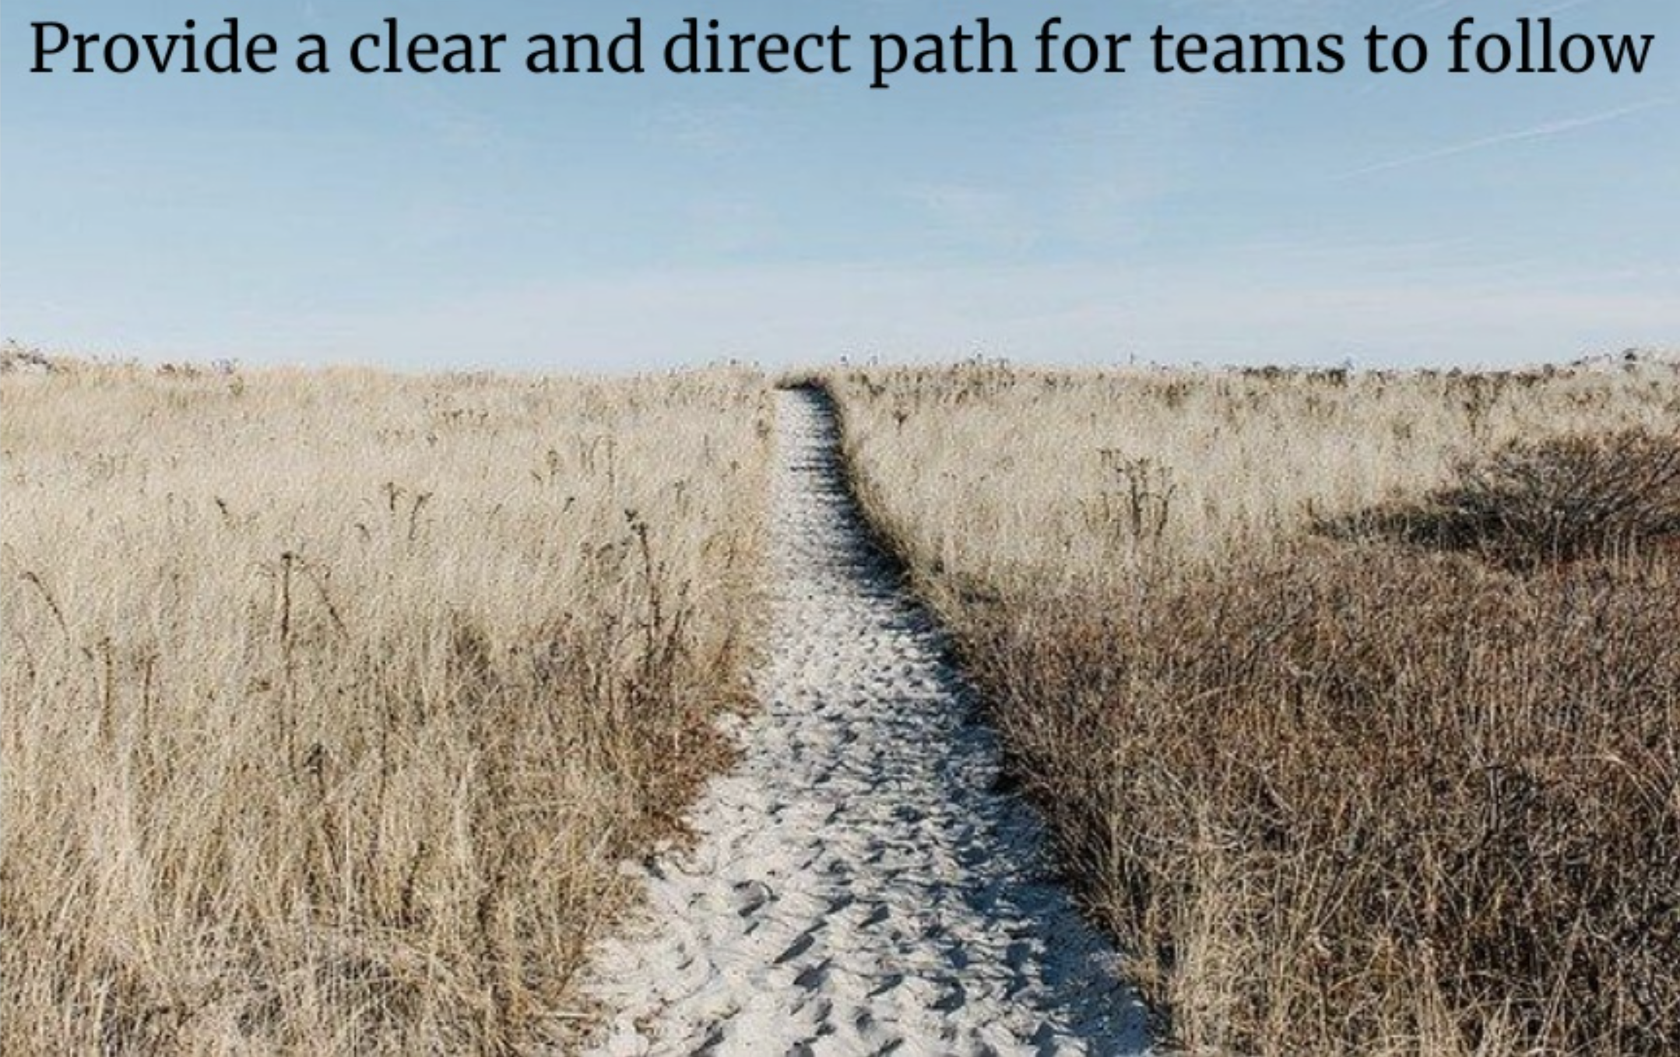
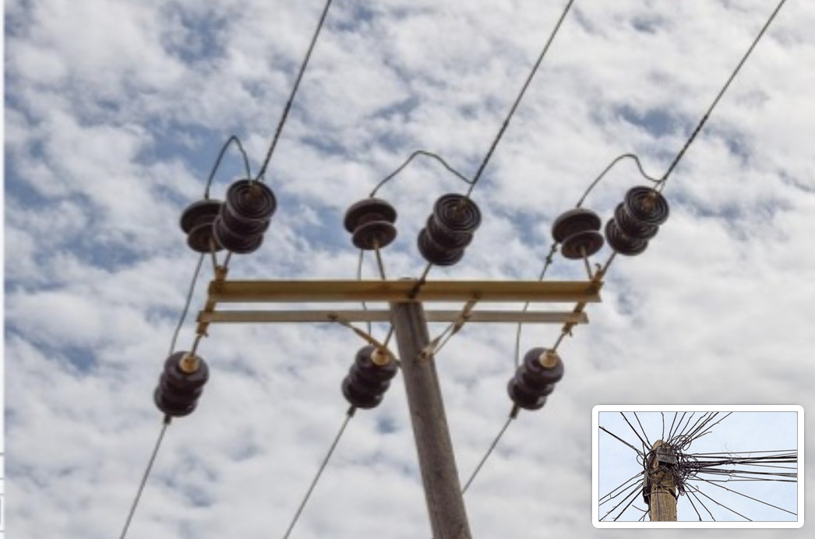
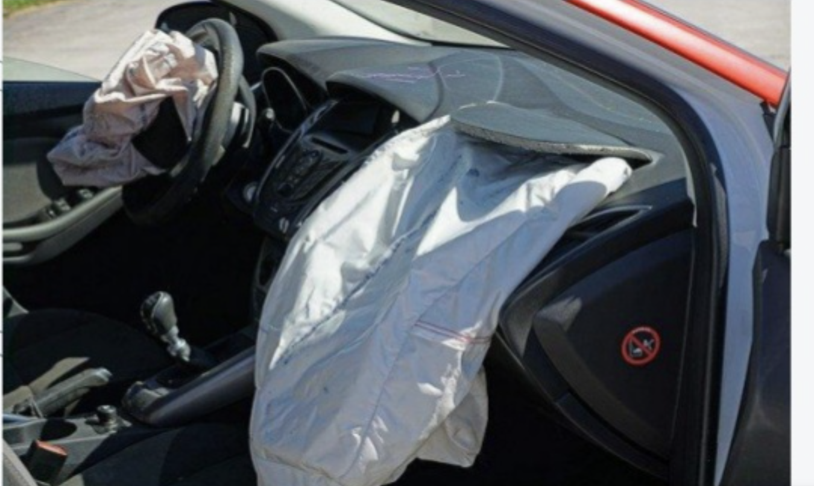
Past
Now
Furure

Slide 30




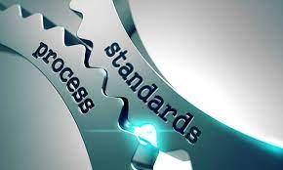
Conclusion
Notes:
the need for developer-centered application security testing tools that target the continuous practices in DevSecOps
achieving a suitable balance between the speed of delivery and security is a significant issue practitioners face in this paradigm.

Slide 31
Thanks!
Email=”toktamr@ifi.uio.no”
10/1/20

Slide 32
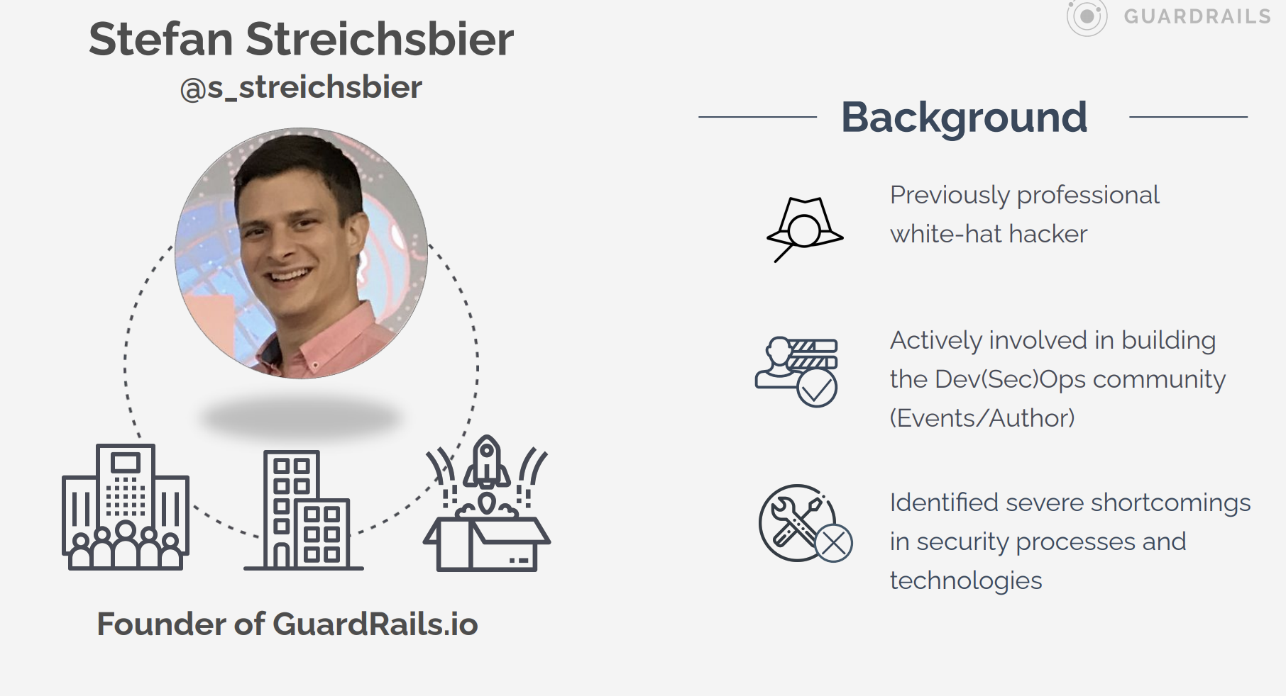
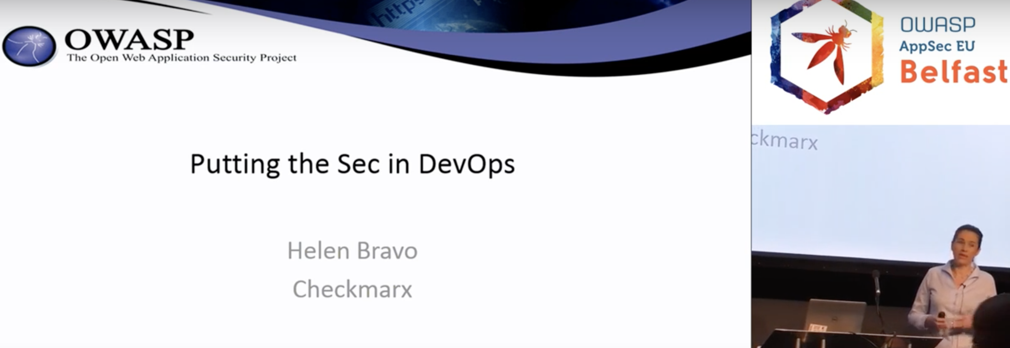
References
Rajapakse, Roshan N., et al. "Challenges and solutions when adopting DevSecOps: A systematic review." arXiv preprint arXiv:2103.08266 (2021).
Heilmann, Jonas. "Application Security Review Criteria for DevSecOps Processes." (2020).
Bitra, Pranavi, and Chandra Srilekha Achanta. "Development and Evaluation of an Artefact Model to Support Security Compliance for DevSecOps." (2021).
Koskinen, Anna. "DevSecOps: building security into the core of DevOps." (2019).

